Slide 1
Bacterial Innoculum.Host Lake.
H = Huron
S = Superior
Total (n) = 60
H.S.
S.S.
S.H.
H.H.
Bacteria
Seston
Bacteria
Seston
Bacteria
Seston
Bacteria
Seston
Experimental
Control
Experimental
Control
X15
X15
X15
X15
Incubation Timeline (Lake Superior Host Lake Example)
0 hour (T₀)
12 hours (T₁)
24 hours (T₂)
36 hours (T₃)
48 hours (T₄)
Destructively sample T0 replicates for experimental and control groups (n = 6).
Destructively sample T1 replicates for experimental and control groups (n = 12).
Destructively sample T2 replicates for experimental and control groups (n = 18).
Destructively sample T3 replicates for experimental and control groups (n = 24).
Destructively sample T4 replicates for experimental and control groups (n = 30).
Analyte | Part CN | Part P | DOC | EEMs | SRP
~ Vol | 360 mL | 360 mL | 40 mL | 40 mL | 50 mL
Seston
~ 100 μm
upper size threshold
Bacteria
Seston
~ 10 μm
Upper size threshold
Analyte | Part CN | Part P | DNA | FC
~ Vol | 360 mL | 360 mL | 480 mL | 3 mL
Bacteria

Slide 2
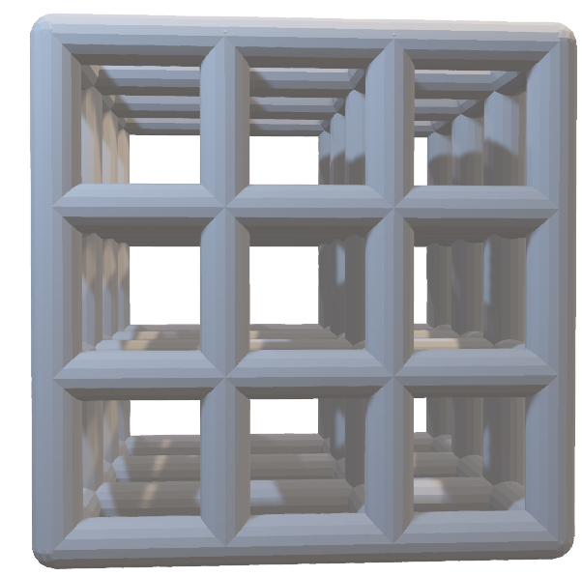
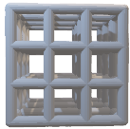
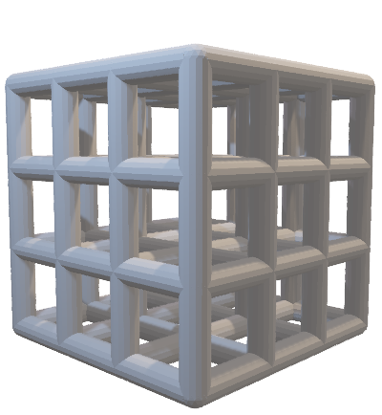
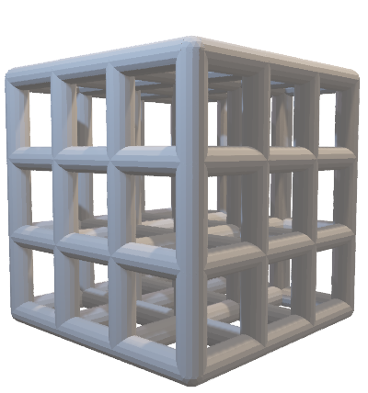
Wood or piece of metal
Lake Superior
Lake Huron
Lake Substrate
Experimental
Control
Experimental
Control

